Slide 1
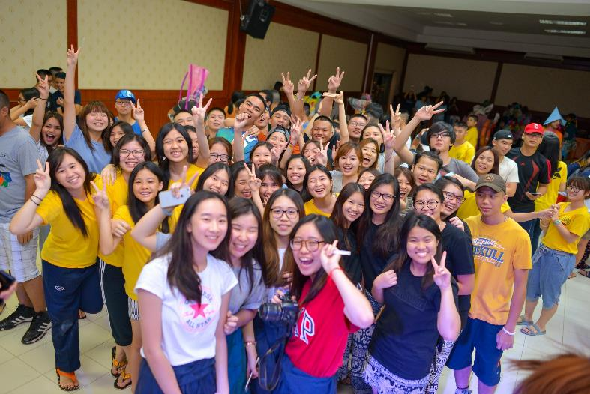
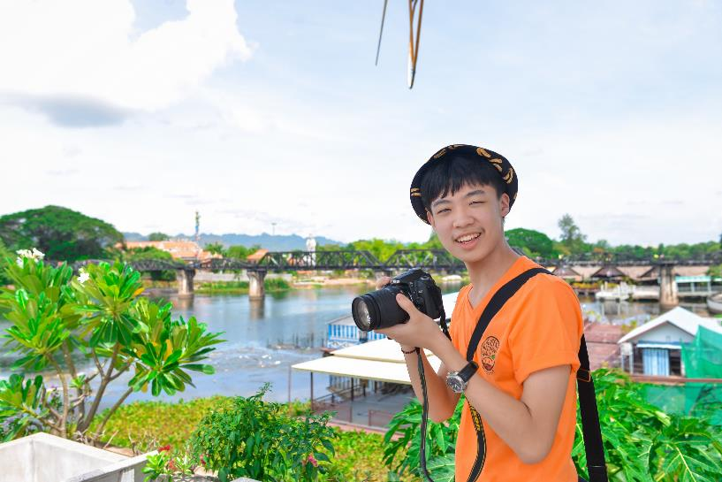
MUIDS Week Without Walls 2016
Grade 10: Kanchanaburi

Slide 2
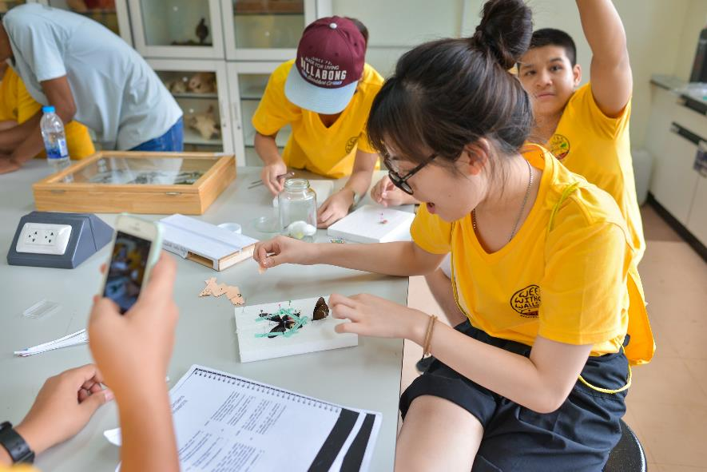
Learning Activities: Science Day
Explore MUKA Campus and Collect Local Insects
Work with MUKA Graduate Students to Identify and Pin the Insects

Slide 3
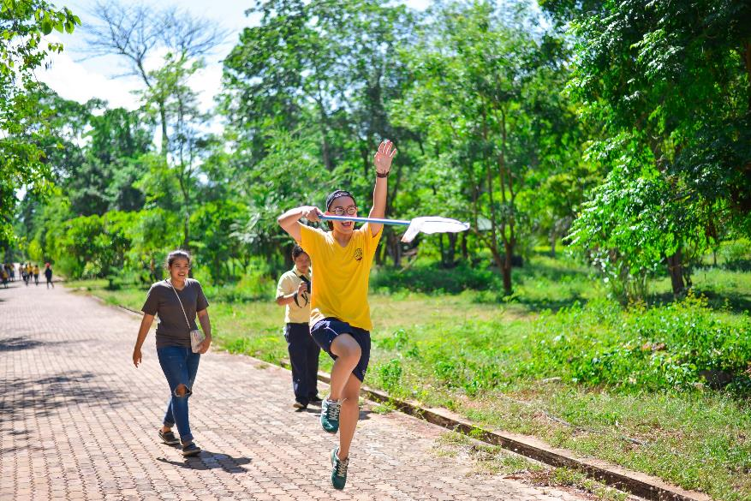
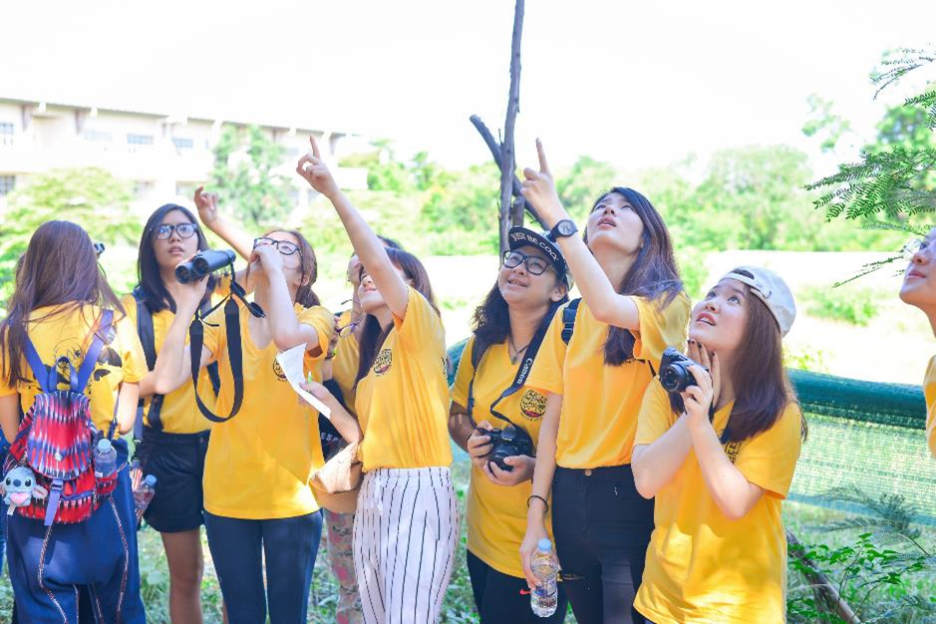
Learning Activities: Science Day

Slide 4
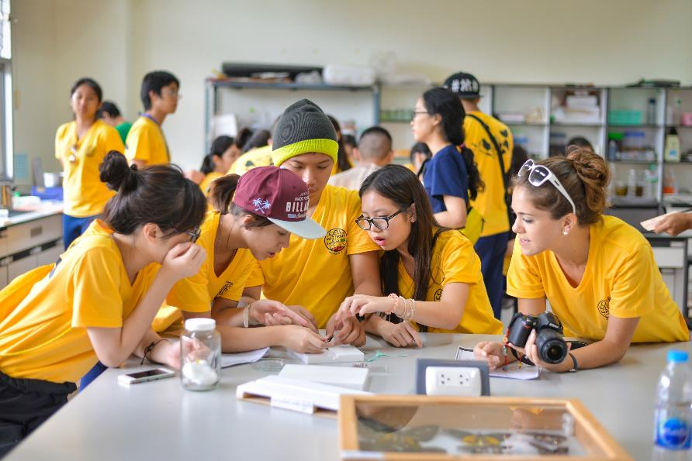
Learning Activities: Science Day

Slide 5
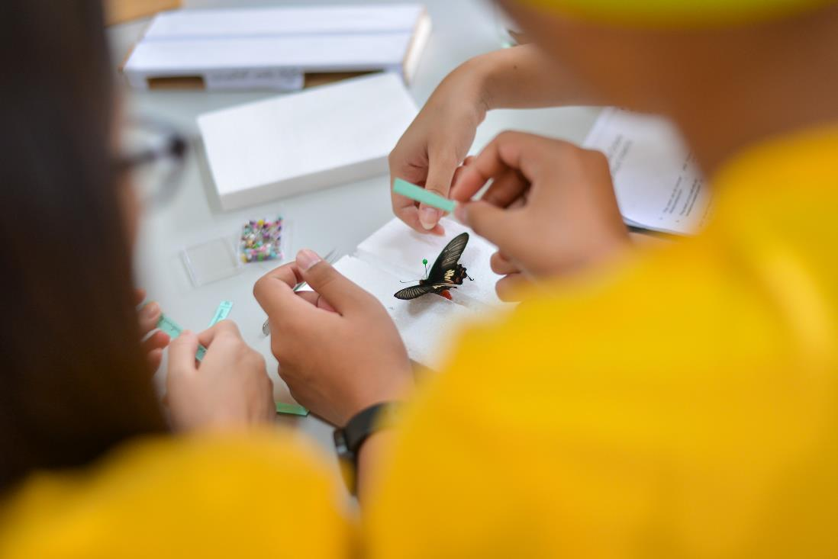
Learning Activities: Science Day

Slide 6
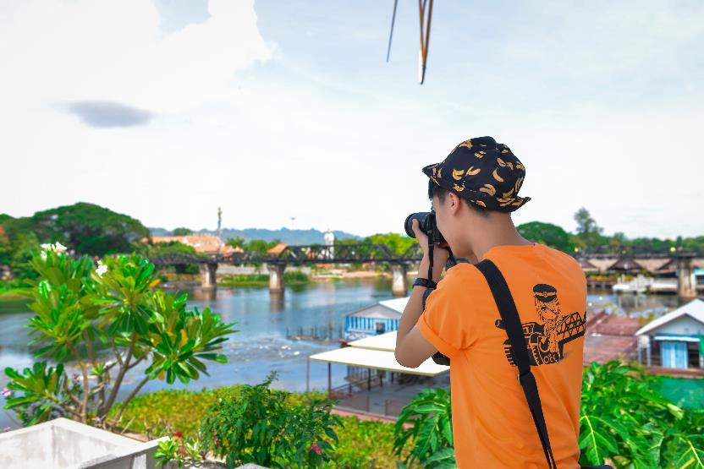
Learning Activities: History / Mathematics Day
See Real Artifacts from WWII at the JEATH Museum and Learn the History of the Japanese Occupation of Thailand
Compete in a Photography Competition and Scavenger Hunt
Geocaching – Use Technology and Observational Skills to Find Hidden Items

Slide 7
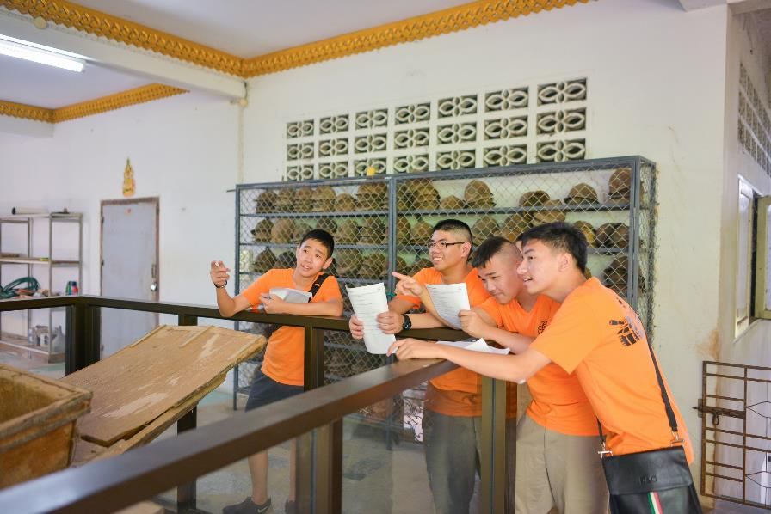
Learning Activities: History / Mathematics Day

Slide 8
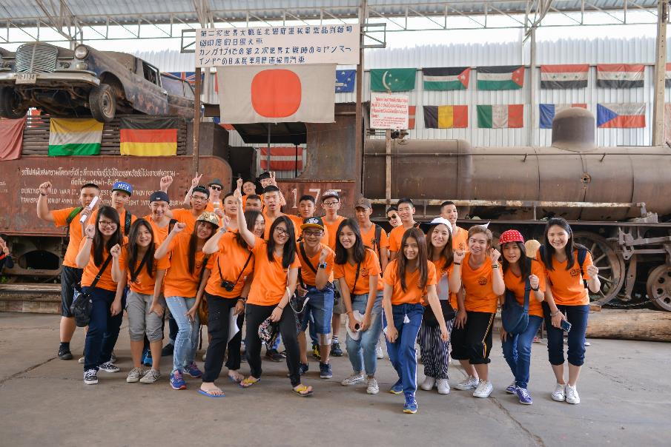
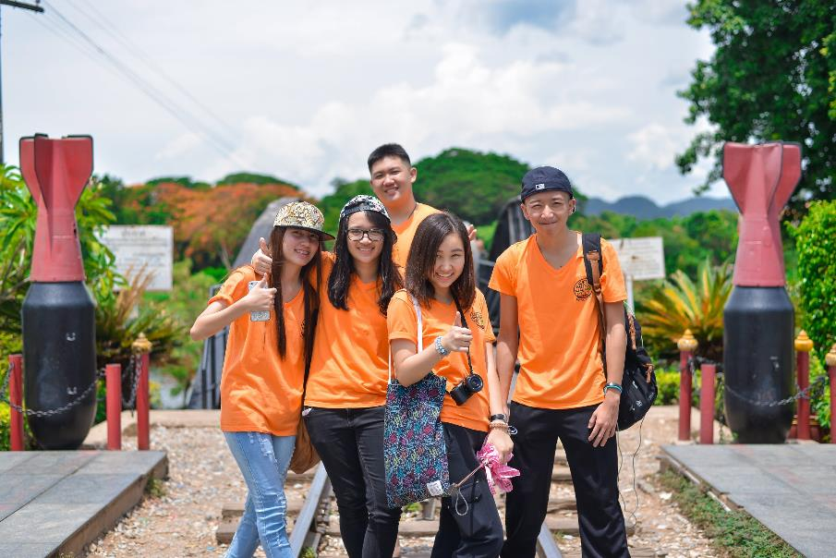
Learning Activities: History / Mathematics Day

Slide 9
Learning Activities: English Day
Visit the Safari Open Park and Zoo
Film Video Footage
Create TV Advertisement to raise awareness on Animal Conservation and Environmental Protection

Slide 10
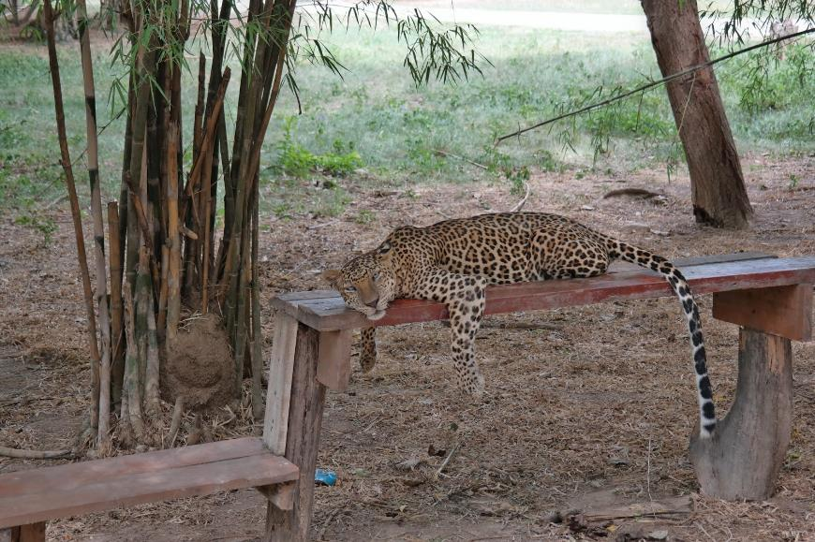
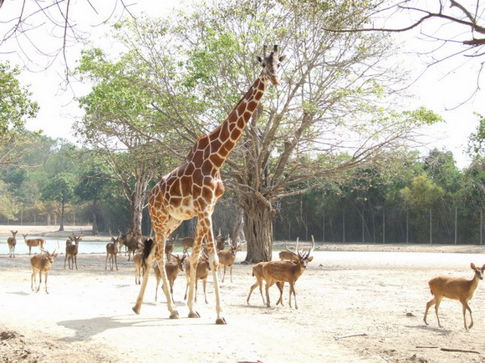
Learning Activities: English Day

Slide 11
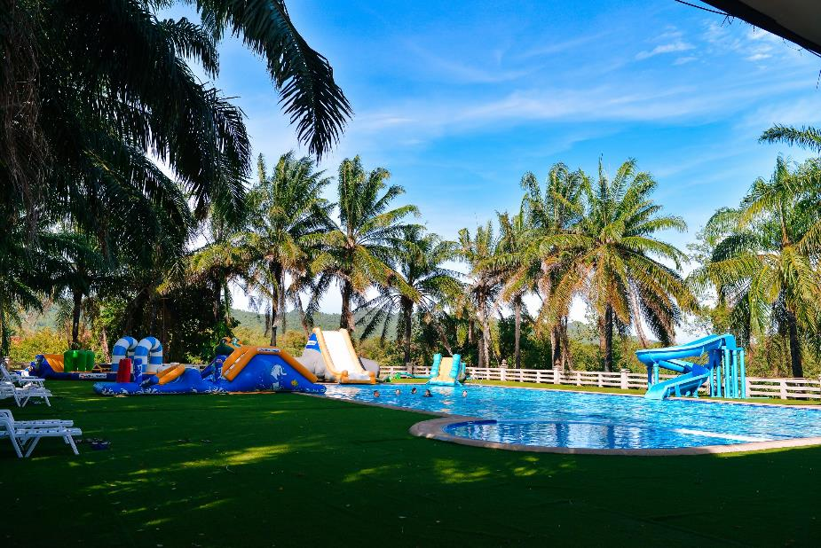
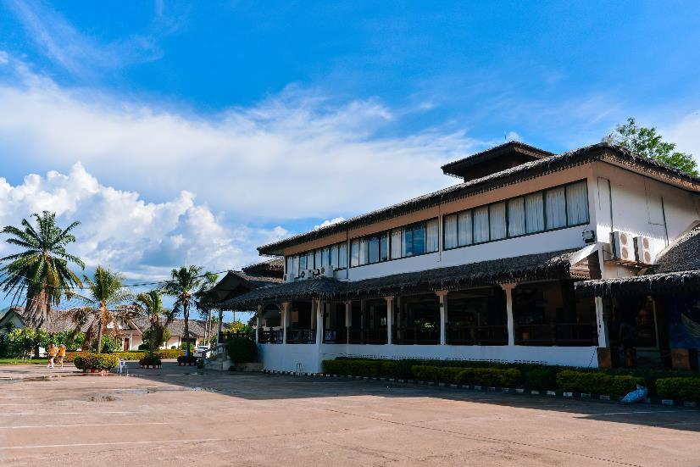
Hotel: Heaven Kwai Resort

Slide 12
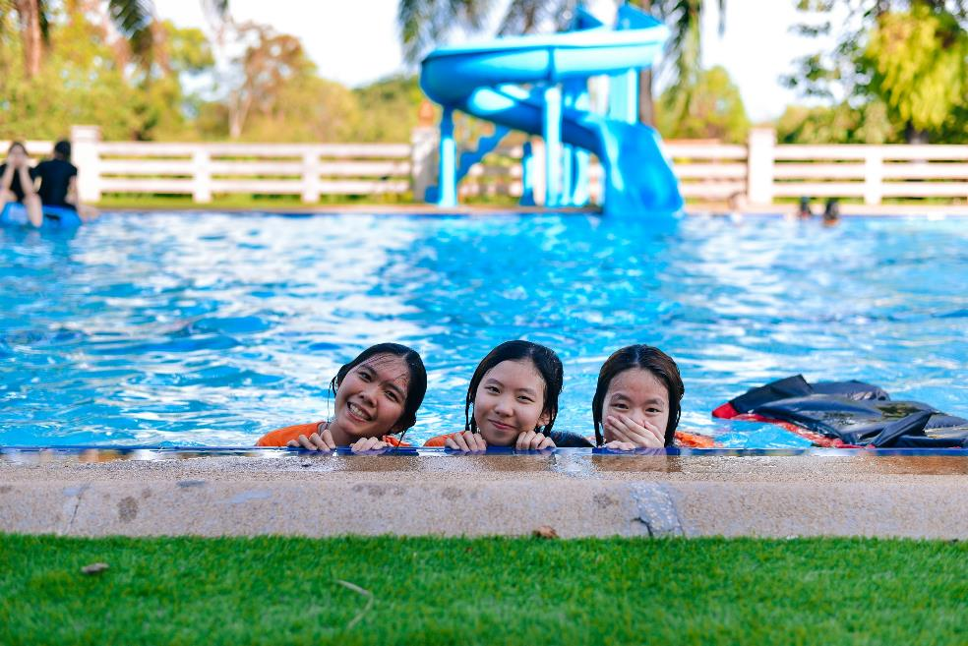
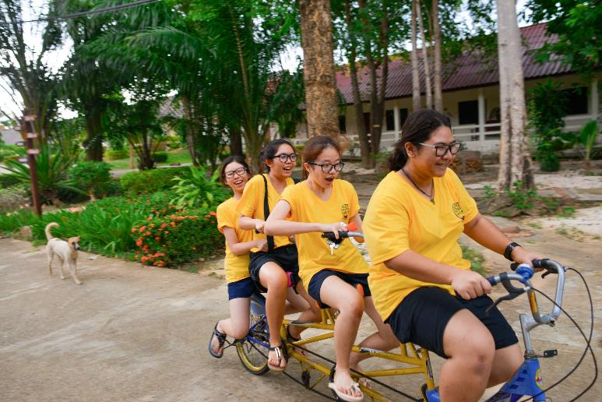
Hotel: Heaven Kwai Resort

Slide 13
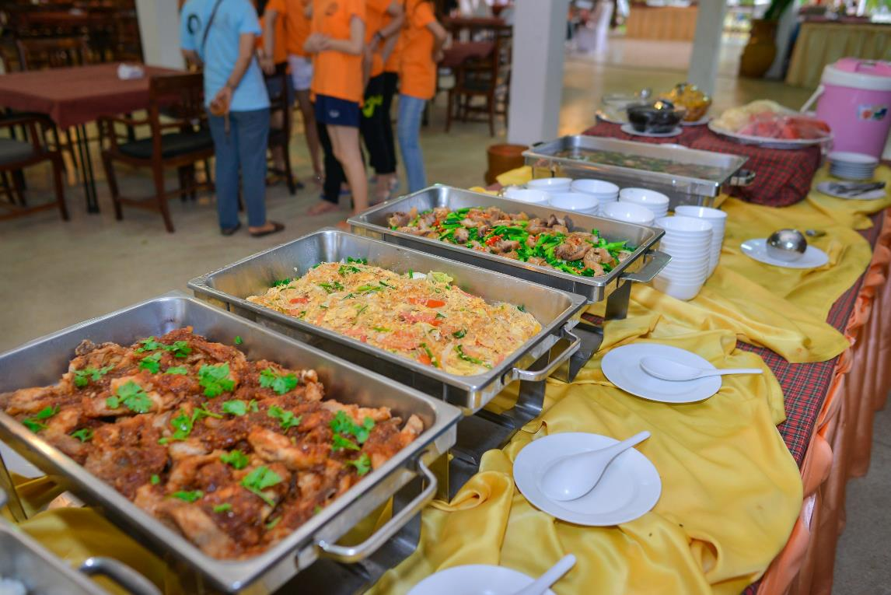

Slide 14
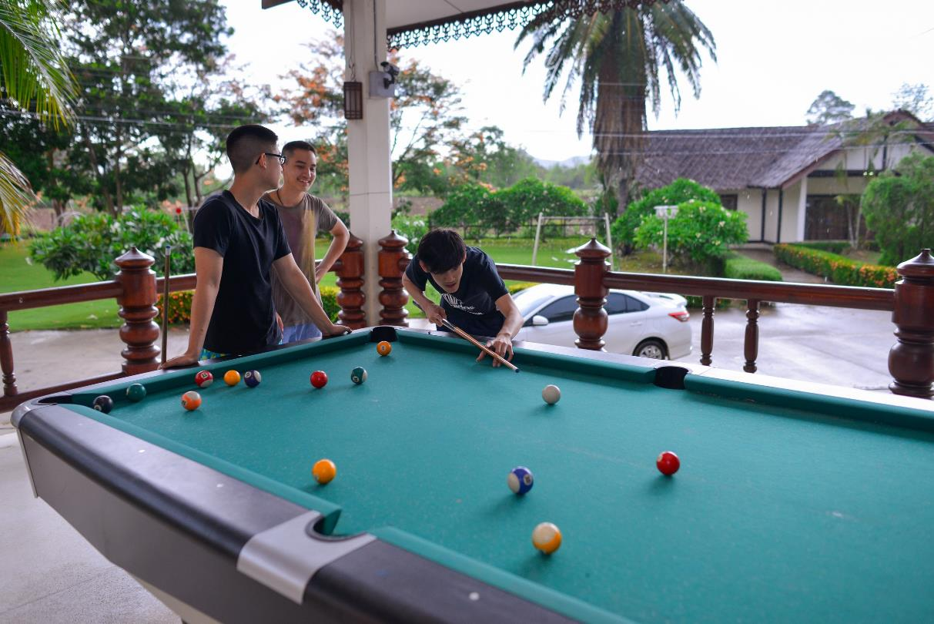

Slide 15
Evening Activities
Games and Competitions
Teacher Fashion Show
Thai Bracelet Ceremony

Slide 16
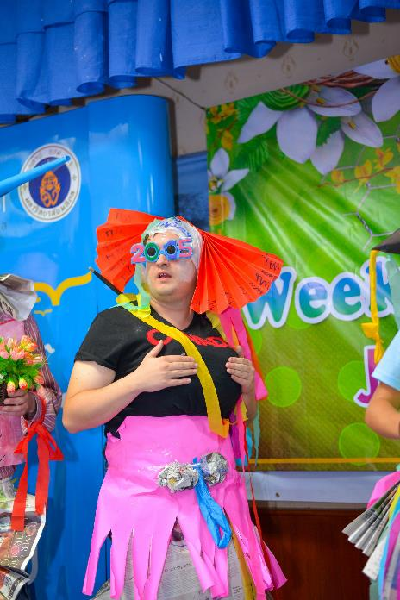
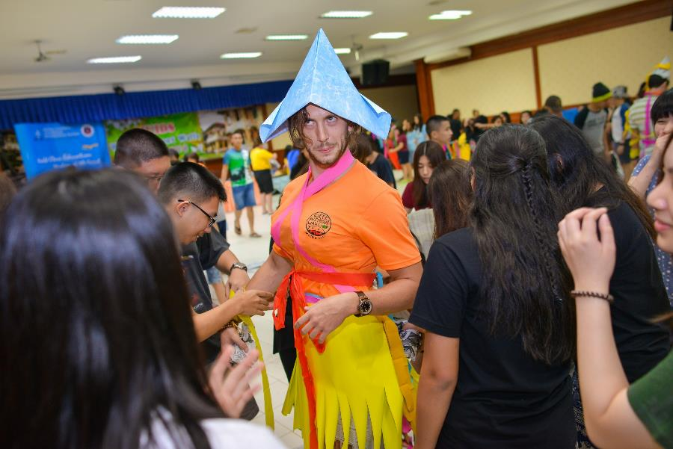
Evening Activities

Slide 17
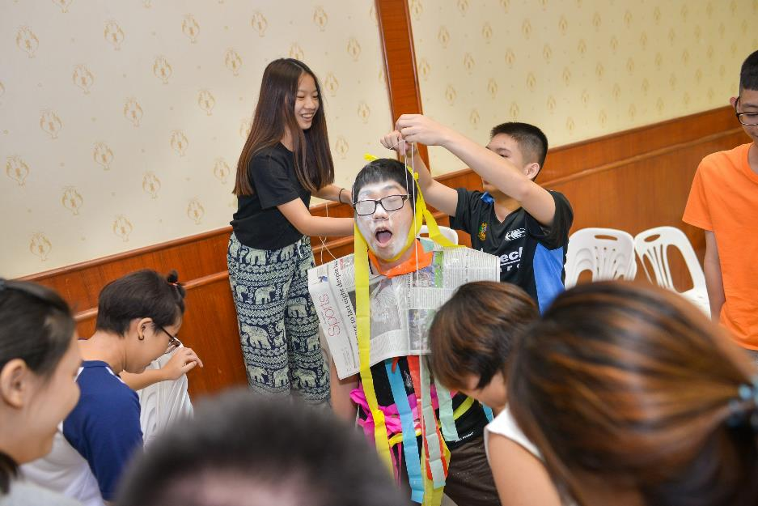
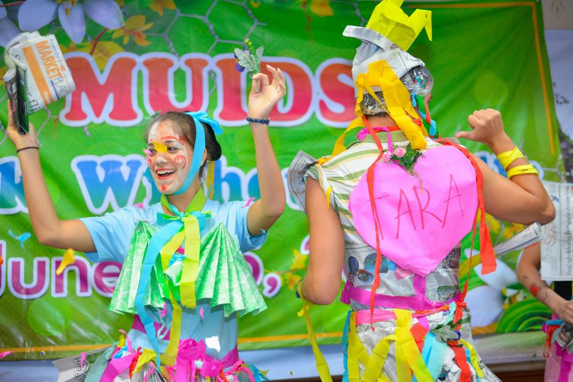
Evening Activities: Fashion Show

Slide 18
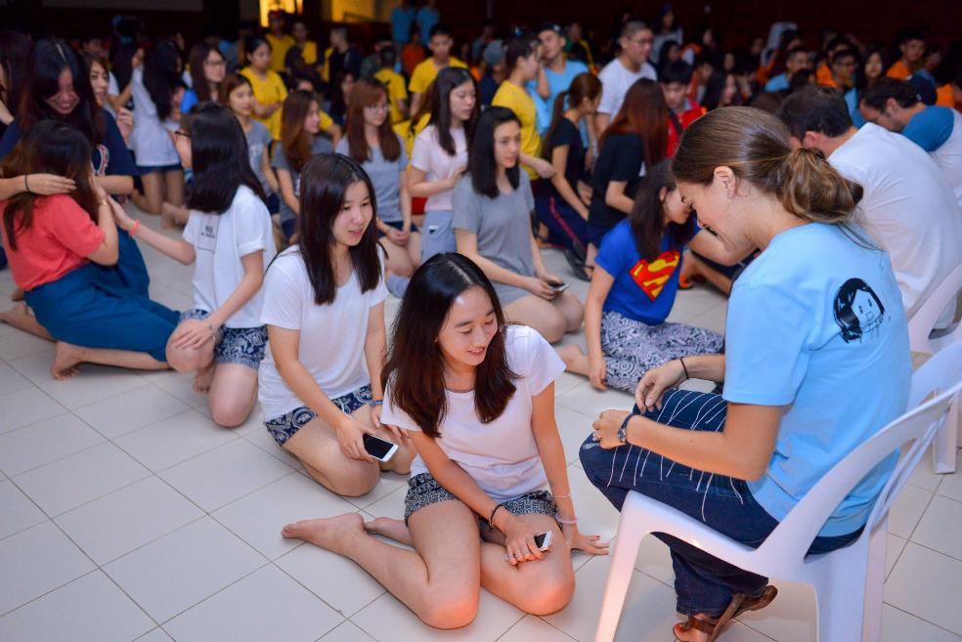
Evening Activities: Bracelet Ceremony

Slide 19
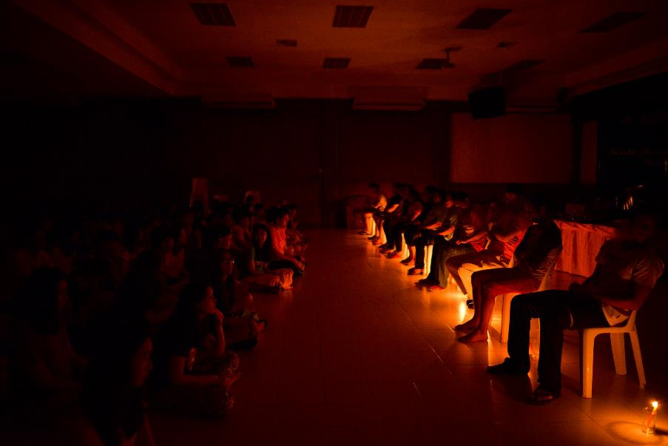
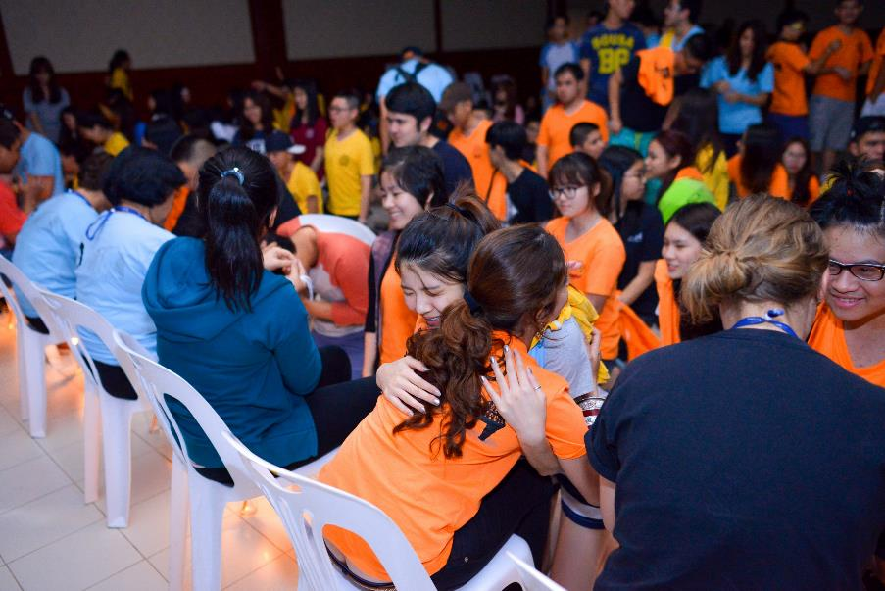
Evening Activities

Slide 20
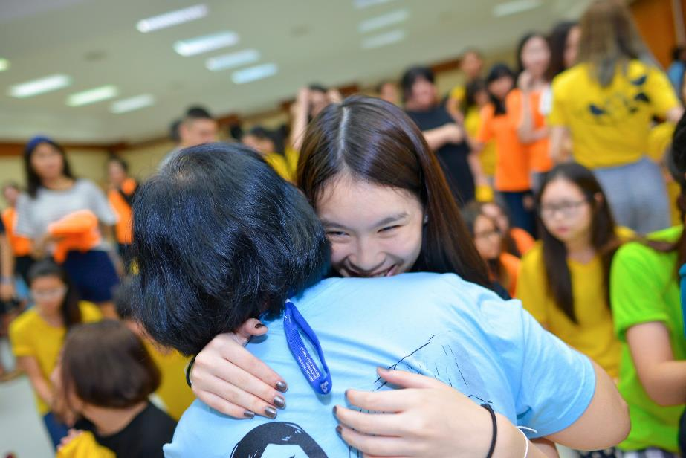
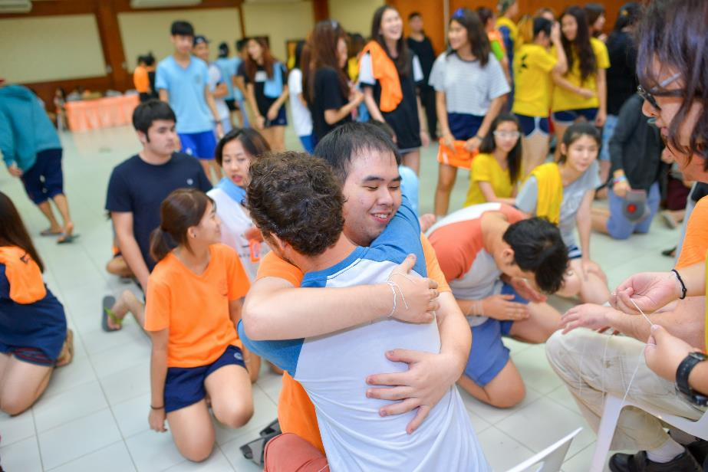

Slide 21
As part of Thai Ministry of Education Requirements, all students must meet 360 of Learner Development Activities to graduate. Any student who misses Week Without Walls will need to plan for and document 80 additional hours for each year that they miss.
 | Week Without Walls Hours Earned | Additional Hours Needed | Total Required Hours
Grade 10 | 80 hours | 40 hours | 120 hours
Grade 11 | 80 hours | 40 hours | 120 hours
Grade 12 | 80 hours | 40 hours | 120 hours
Total | 240 hours | 120 hours | 360 hours

Slide 22
Follow the School Rules.
You must stay in the rooms you are assigned.
Follow the curfew times.
No girls in the boy’s rooms. No boys in the girl’s rooms.
Use of drugs and / or alcohol will be treated as a serious offense.
No tobacco products of any kind.
Follow the dress code (Week Without Walls T-Shirts during day, Free Dress Day rules for Evening Activities)
You are here to learn. Participate in all educational activities.
Remember you are representing your school and Mahidol University.
2016 Rules and
Regulations
Behave on the bus and in the vans.
Chaperones have the final say and the right to discipline students.
Students who break the rules will be punished by the MUIDS discipline handbook, may lose the privilege of participating in activities and in serious cases may be sent home. See your packet for details.

Slide 23
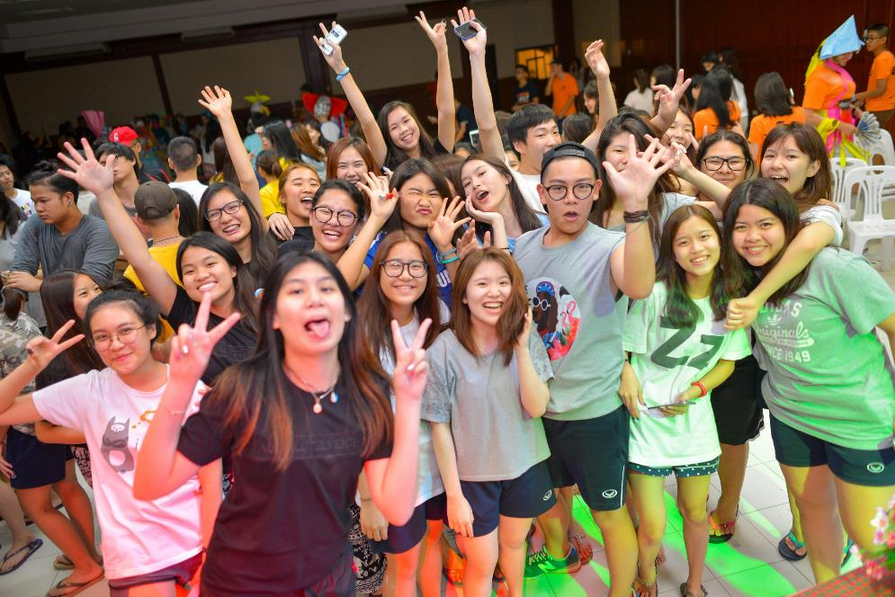
Have Fun with Your Friends

Slide 24
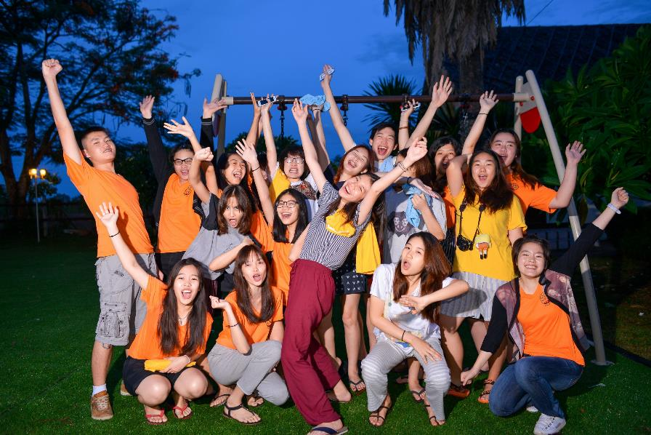
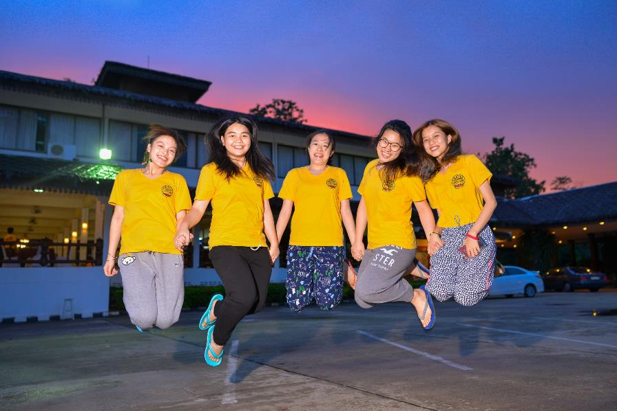
Have Fun with Your Friends

Slide 25
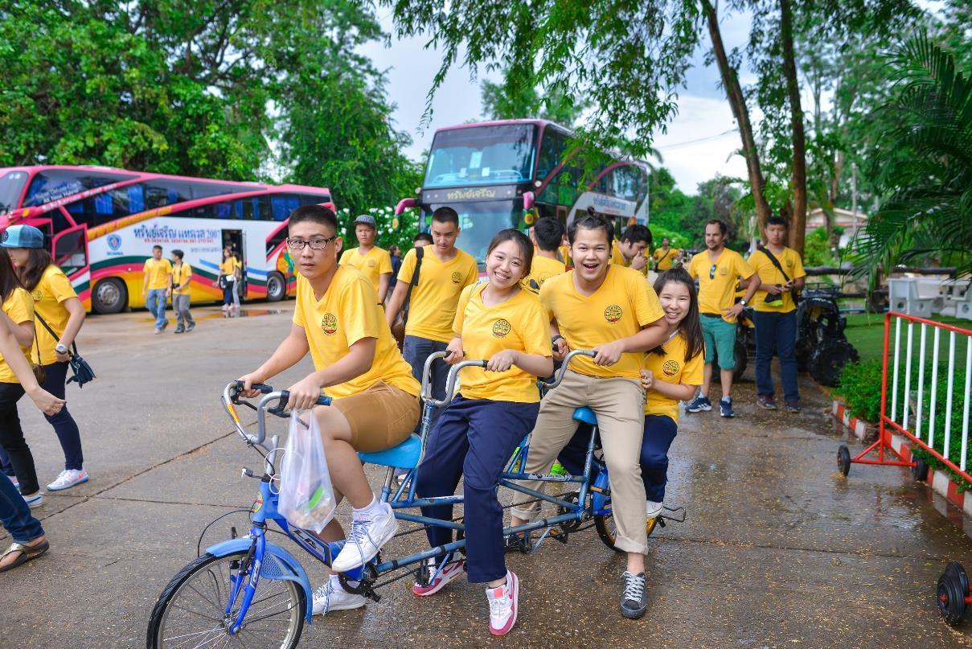

Slide 26
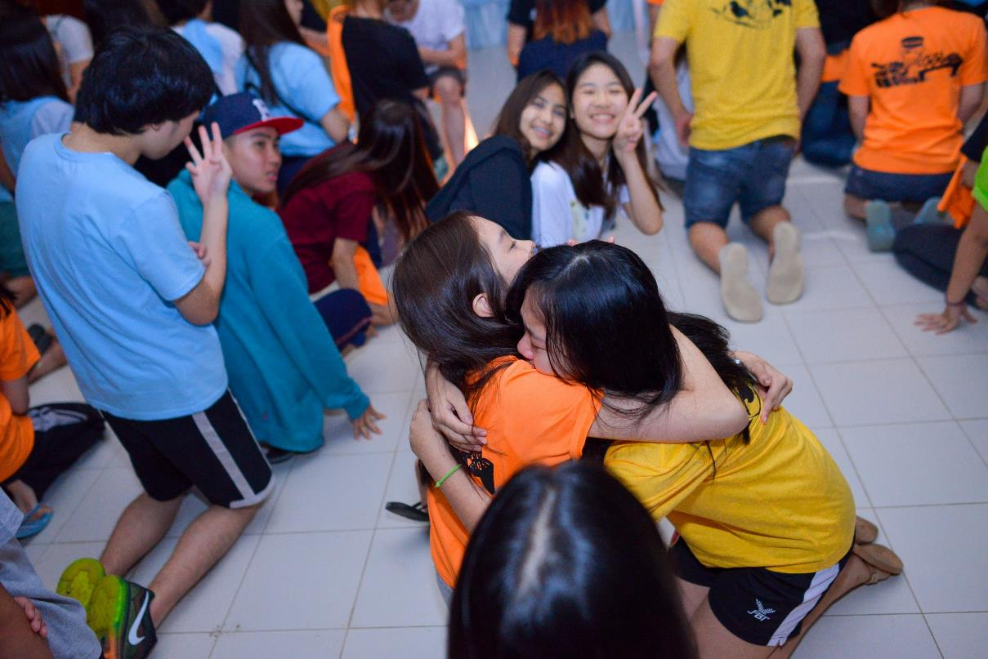

Slide 27
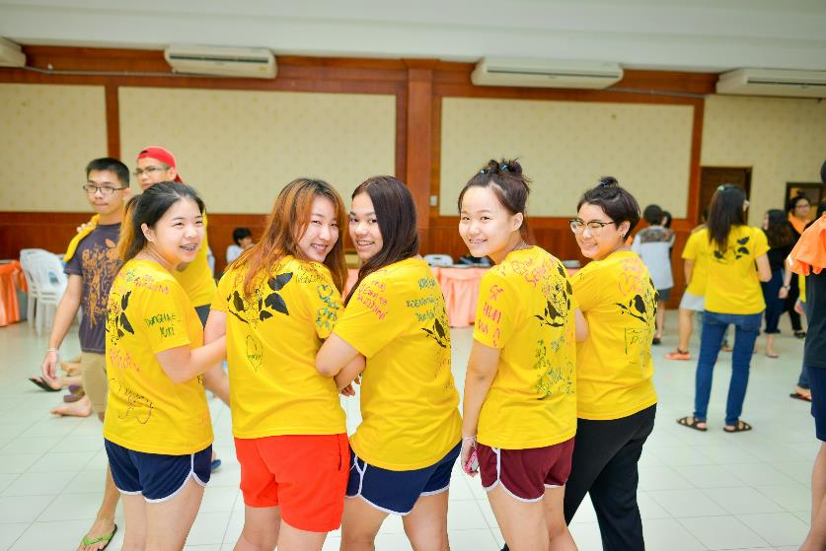

Slide 28
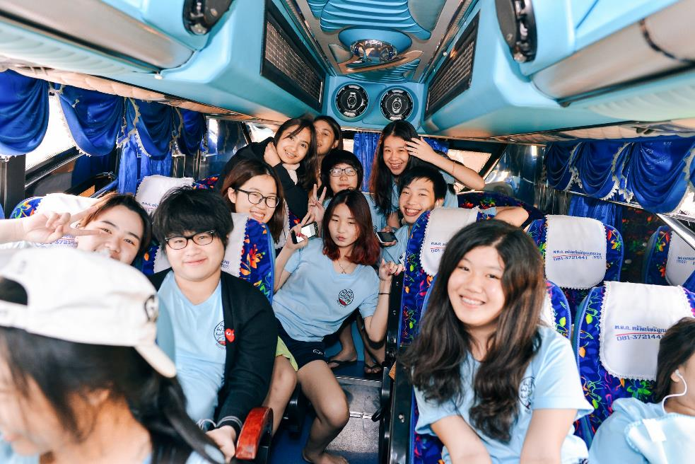
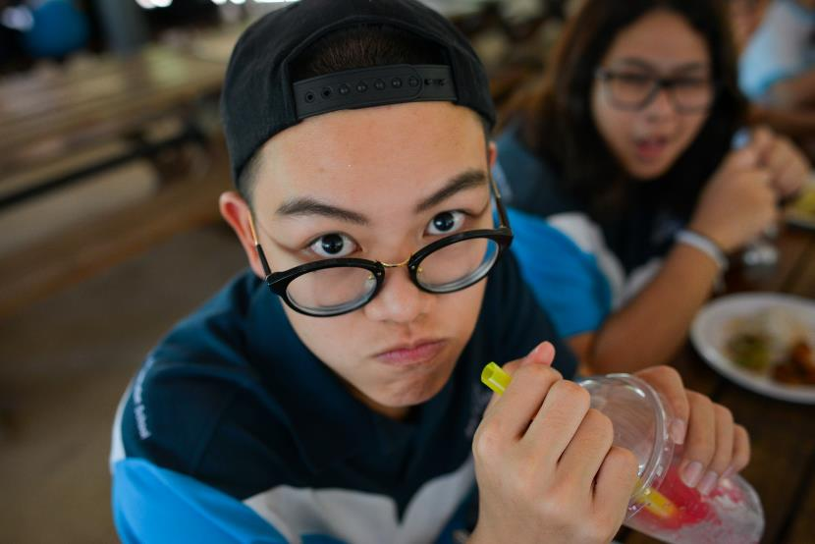

Slide 29
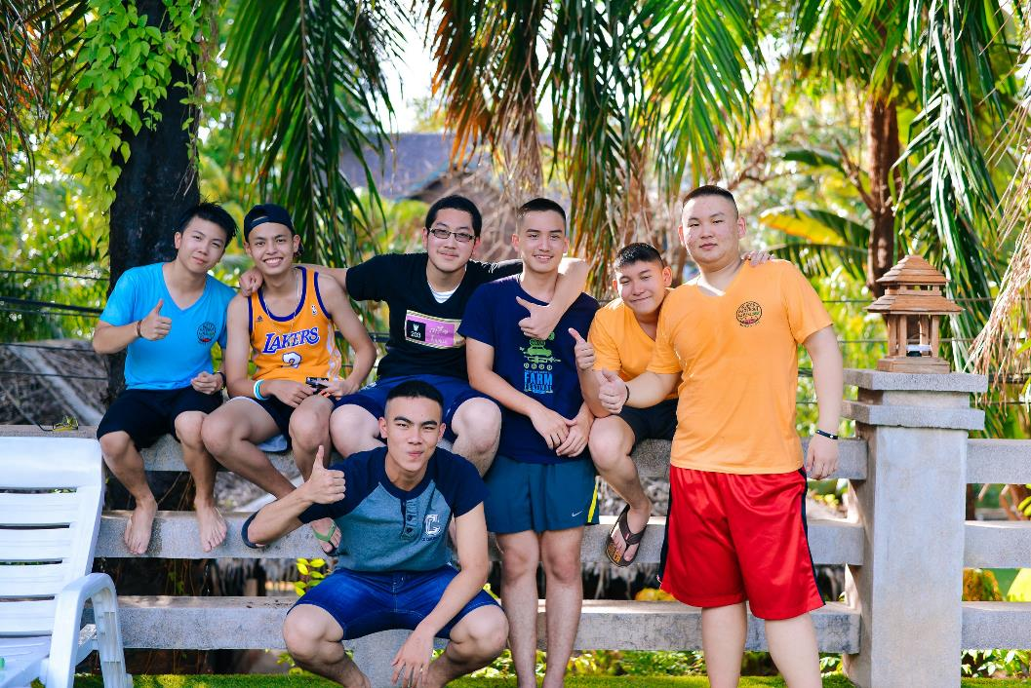

Slide 30
